Slide 1

Analytics In Government
Created By: Ashutosh Lall

Slide 2
What is Analytics?
Analytics is an encompassing and multidimensional field that uses mathematics, statistics, predictive modeling and machine learning techniques to find meaningful patterns and knowledge in recorded data.
It helps us answer questions like,
What happened?
How or why did it happen?
What’s happening now?
What is likely to happen next?

Slide 3
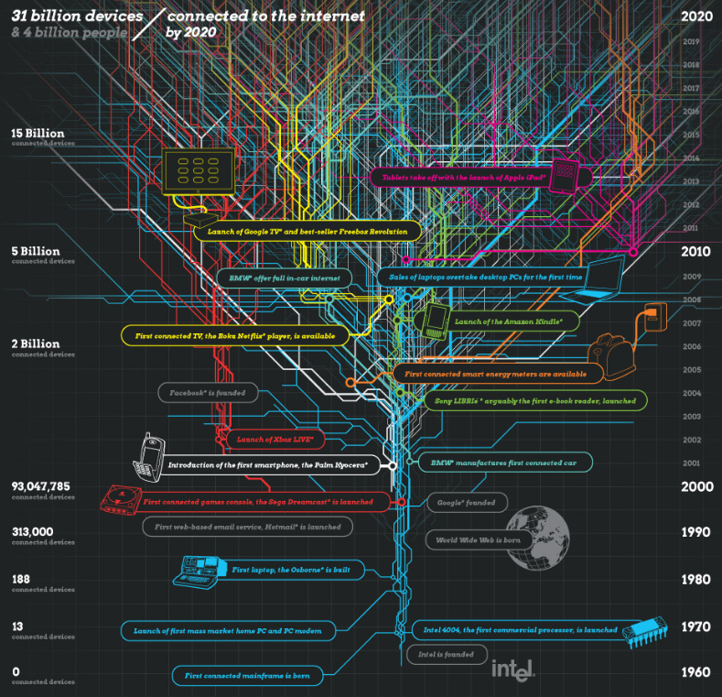
Amount of data in the world is increasing every day
Governments are the largest collectors of social, economic, health and defense related data.

Slide 4
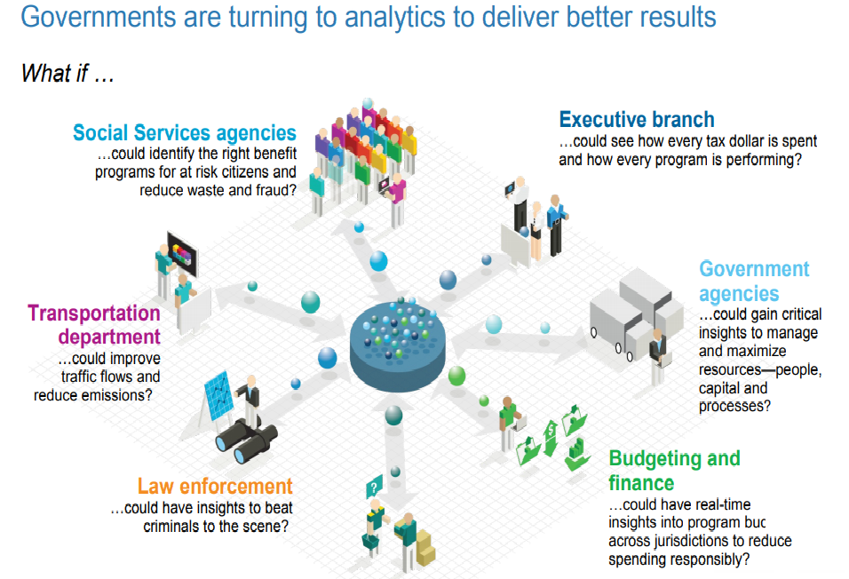
How can analytics be used in governments?

Slide 5


Examples of use of analytics in government
Weather Patterns
The Joint Polar Satellite System (JPSS) monitors environmental conditions and the JPSS Common Ground System draws data from sensors and satellites.
Law enforcement
Neptune and Cerberus are used by the Department of Homeland Security (DHS) to track crime and terrorist threats

Slide 6

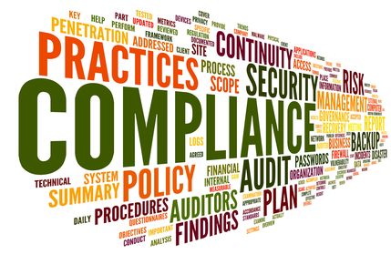
Examples of use of analytics in government
Health and safety
Agencies target which buildings, restaurants, and manholes to inspect by predictively modeling which have the greatest risk of health hazards.
Regulatory compliance
The ECHO database provides integrated compliance and enforcement data, including a history of compliance. The data can be used by different types of agencies in order to assess compliance.

Slide 7
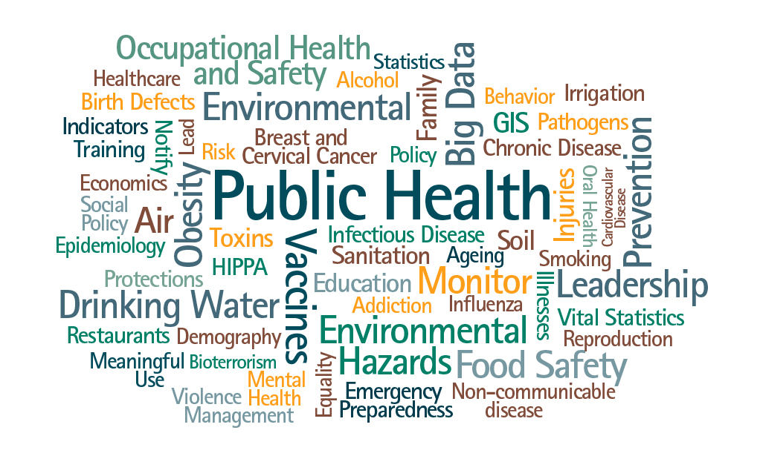
Successful implementation of analytics in governance
Public Health
Chicago used advanced data analytics to enhance the process by which health inspectors identify food establishments likely to have critical violations.
The city processed open data to find variables that predict violations, developed a model, ran a simulation and used the forecast to allocate inspections more efficiently.

Slide 8
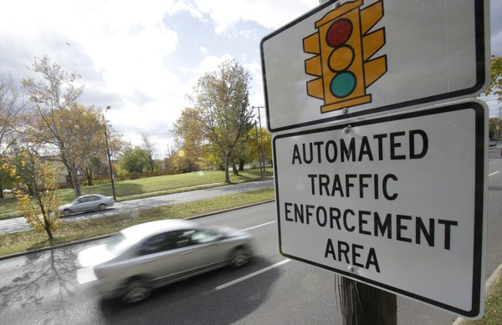
Successful implementation of analytics in governance
Reducing Traffic Accidents
A number of US cities have implemented the Vision Zero initiative, a campaign that aims to eliminate traffic fatalities through education, enforcement, and engineering.
Through data analytics and GIS analysis, the Department of Transportation (DOT) identified 14 Priority Safety Corridors, where a significant share of fatal and major injury collisions occur; these will be the primary focus of initial engineering and enforcement efforts.

Slide 9

The future of analytics in government
Technological companies like IBM, Oracle, Tableau, Cisco coming out with products aimed at public sector and government agencies.
Deloitte, KPMG, McKinsey all having dedicated departments for federal analytical advisory.
Adoption of new ideas and technologies is an inevitability!

Slide 10


Slide 11
Thank you!

